Slide 1

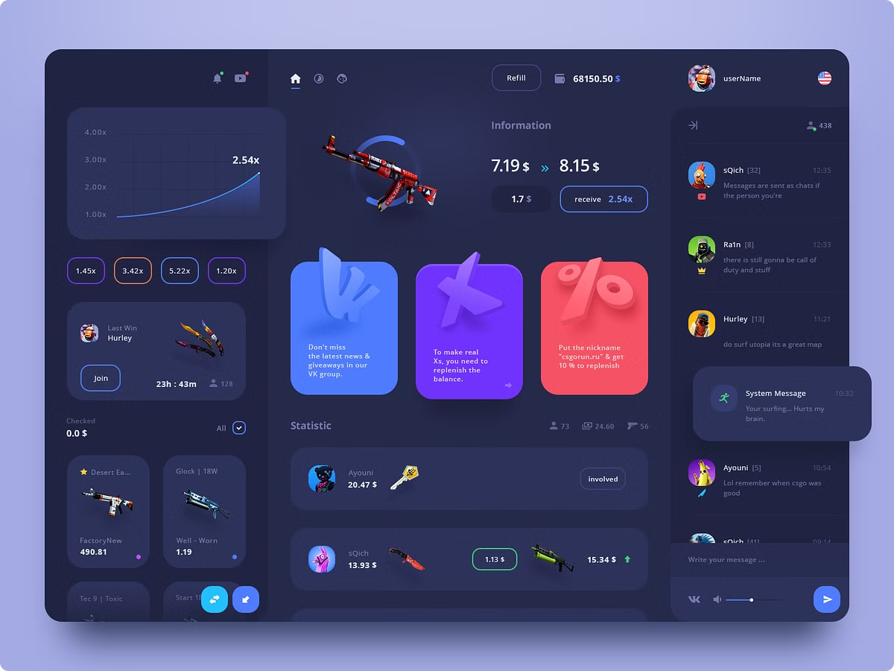
Webapp Design Fundamentals
Designing effective web applications (webapps) requires a deep understanding of user experience, visual aesthetics, content architecture, and technical constraints. This chapter explores the key principles and best practices for creating high-quality, engaging webapps that meet the diverse needs of modern users and businesses.
by Peter Njathi
PN

Slide 2
Design Goals for Successful Webapps
Usability
Aesthetics
Performance
Webapps must be intuitive, efficient, and easy to navigate. Key usability considerations include clear information architecture, responsive layout, and seamless user flows.
Visual design plays a crucial role in creating an engaging and memorable user experience. Effective webapp aesthetics balance typography, color, imagery, and layout to establish a strong brand identity.
Webapps must deliver fast, reliable performance to meet user expectations. Optimizing load times, server responsiveness, and overall system stability is essential for retaining users and maintaining business continuity.

Slide 3
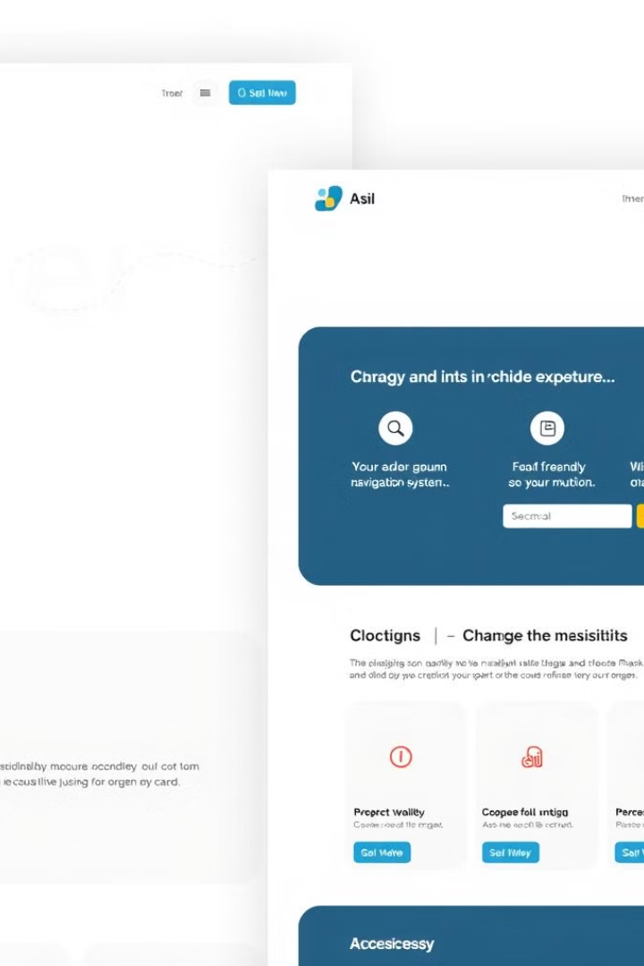
Principles of Webapp Interface Design
1
Intuitive Navigation
Users should be able to intuitively understand how to move through the webapp and find the information or functionality they need. Clear, consistent navigation is key.
2
Responsive Layout
The webapp's layout should adapt seamlessly to different screen sizes and devices, ensuring an optimal user experience across all platforms.
3
Accessibility
Webapps must be designed to accommodate users with disabilities, following established accessibility guidelines and best practices.
4
Consistency
Consistent visual design, interaction patterns, and terminology throughout the webapp help users feel confident and in control.

Slide 4

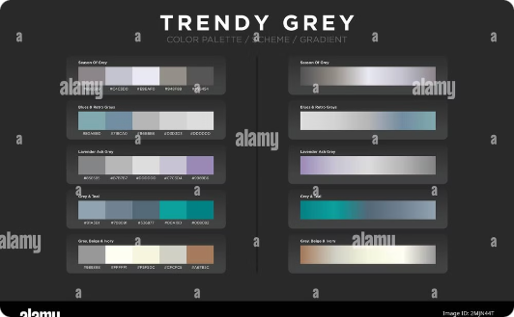

Aesthetic Design Considerations
Layout
Color and Imagery
Grid-Based Design
The webapp's layout should be clean, balanced, and responsive, guiding users' attention to the most important content and functionality.
Strategic use of color, typography, and high-quality imagery can enhance the webapp's visual appeal and reinforce its brand identity.
Applying a consistent grid-based layout helps create a visually cohesive and organized webapp, improving the user experience.

Slide 5
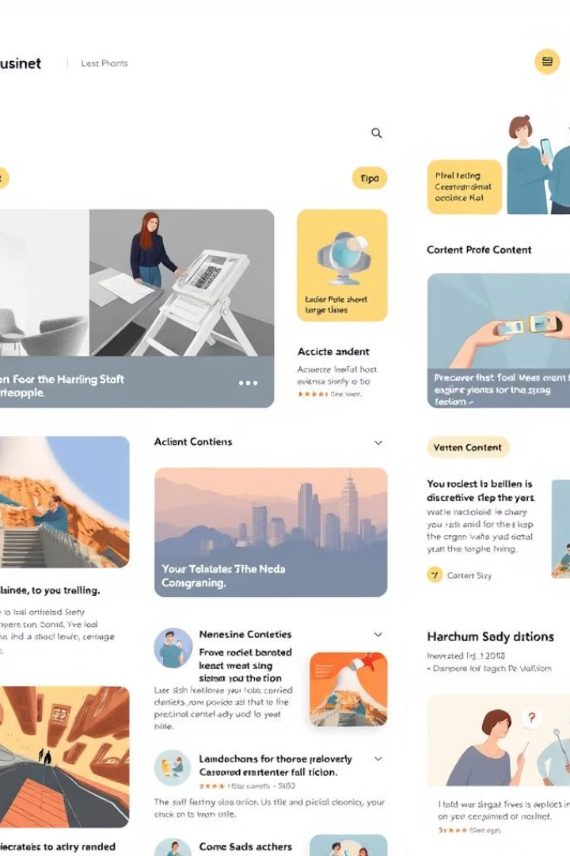
Designing Effective Content
Content Objects
Webapps typically consist of various content objects, such as articles, images, videos, and interactive elements, which must be organized and presented in a way that enhances the user experience.
Content Hierarchy
Establishing a clear content hierarchy helps users quickly identify the most important information and navigate the webapp effectively.
Microcopy
Carefully crafted microcopy, such as labels, tooltips, and error messages, can significantly improve the overall usability and clarity of the webapp.
Content Optimization
Optimizing content for search engines, accessibility, and mobile devices ensures that the webapp's content reaches the widest possible audience.

Slide 6

Architecting Webapps for Success
1
Content Architecture
Designing the webapp's content architecture involves organizing content into a logical, user-friendly structure, ensuring seamless navigation and content discovery.
2
Technical Architecture
The technical architecture of a webapp encompasses the backend systems, API integrations, and frontend frameworks that power the application's functionality and performance.
3
Modular Design
Adopting a modular design approach allows for greater flexibility, scalability, and maintainability of the webapp, making it easier to adapt to changing user needs and technological advancements.

Slide 7





Navigating Webapps with Ease
Search
Menu Navigation
Breadcrumbs
Tabs and Accordions
Robust search functionality enables users to quickly find the content or features they're looking for, improving overall productivity and satisfaction.
A well-designed menu system, with clear labeling and intuitive organization, helps users explore the webapp's content and functionality with ease.
Breadcrumb navigation provides users with a clear understanding of their current location within the webapp, allowing them to easily navigate back to higher-level pages.
Organizing content into tabs, accordions, and other collapsible interface elements can help reduce visual clutter and improve the webapp's information architecture.

Slide 8




Component-Level Design
UI Components
Interaction Design
Microtransitions
Designing reusable UI components, such as buttons, forms, and cards, ensures consistency and efficiency throughout the webapp's interface.
Carefully considering the behavior and responsiveness of interactive elements, such as hover effects and form validations, enhances the overall user experience.
Implementing subtle, dynamic microtransitions between interface elements can create a polished, responsive, and engaging user experience.

Slide 9
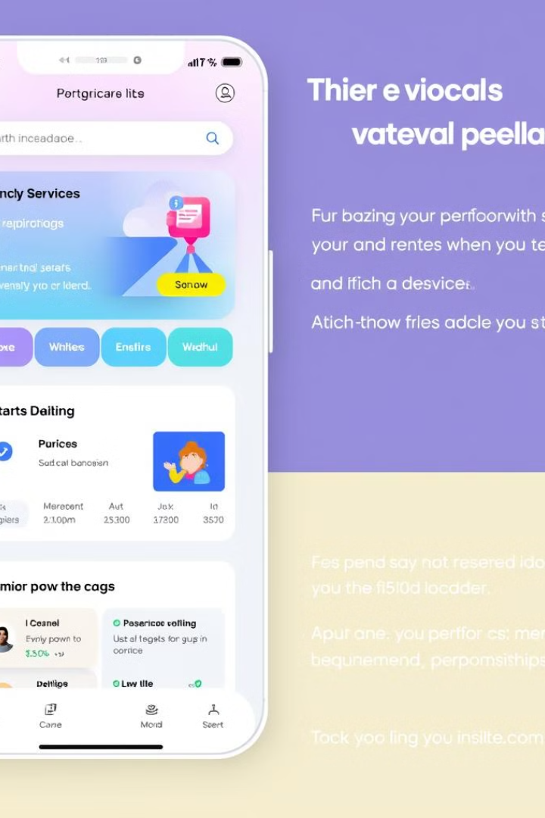
Bringing it All Together
Design Principles
Key Considerations
Recommended Practices
Usability
Intuitive navigation, responsive layout, accessibility
Establish clear information architecture, optimize for mobile, follow WCAG guidelines
Aesthetics
Layout, color, typography, imagery
Adopt a consistent grid-based design, use high-quality visuals, establish brand identity
Performance
Load times, server responsiveness, stability
Optimize code, leverage caching, implement robust error handling

